Slide 1

Loan Calculator
Lee Prather, Brisaac Johnson, Darius Fiallo, Austin Lorans

Slide 2
Goal of the app
Let users input a loan amount and get a breakdown of the loan by pressing the app icon button.

Slide 3
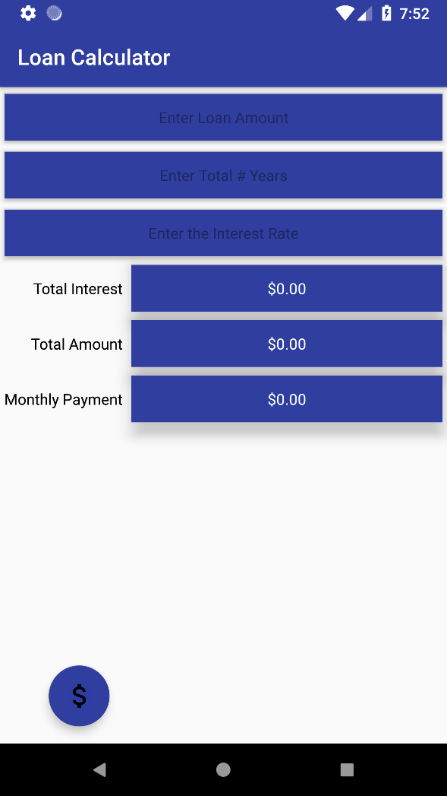
Opening

Slide 4
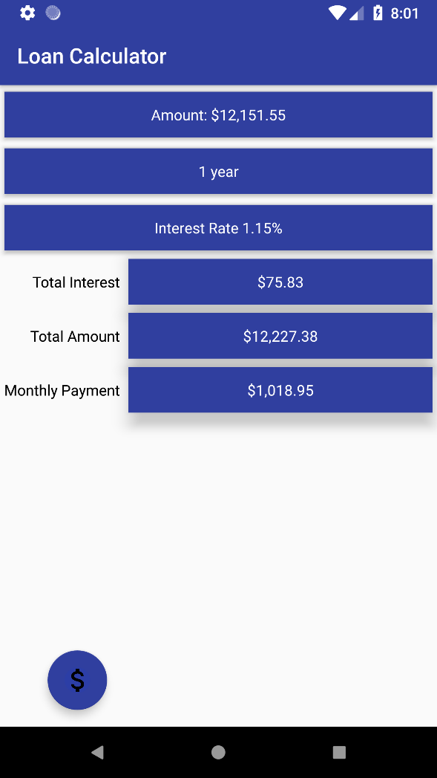
Inputting into the app

Slide 5
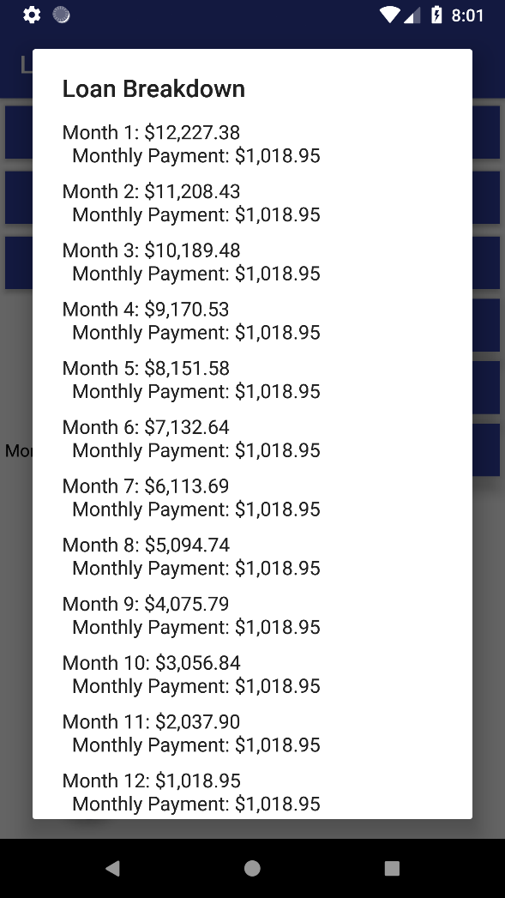
Loan Breakdown

Slide 6
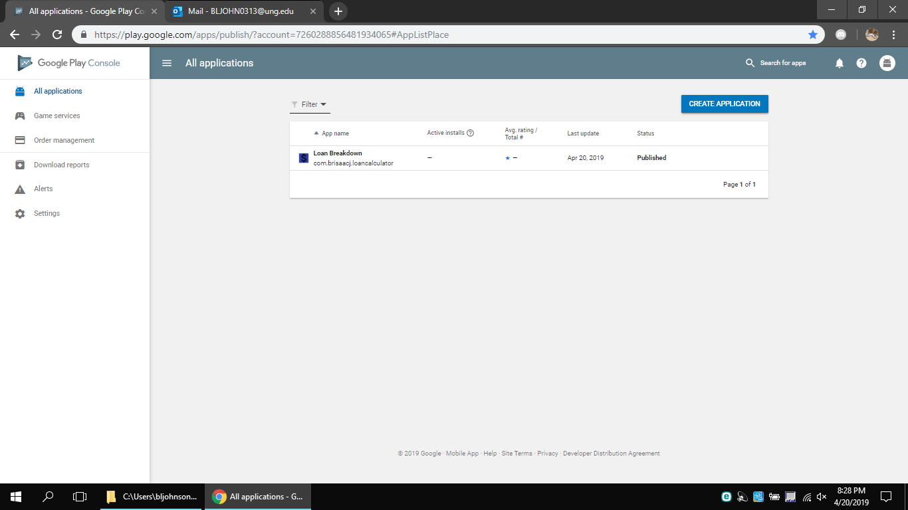
Play Store Publication

Slide 7
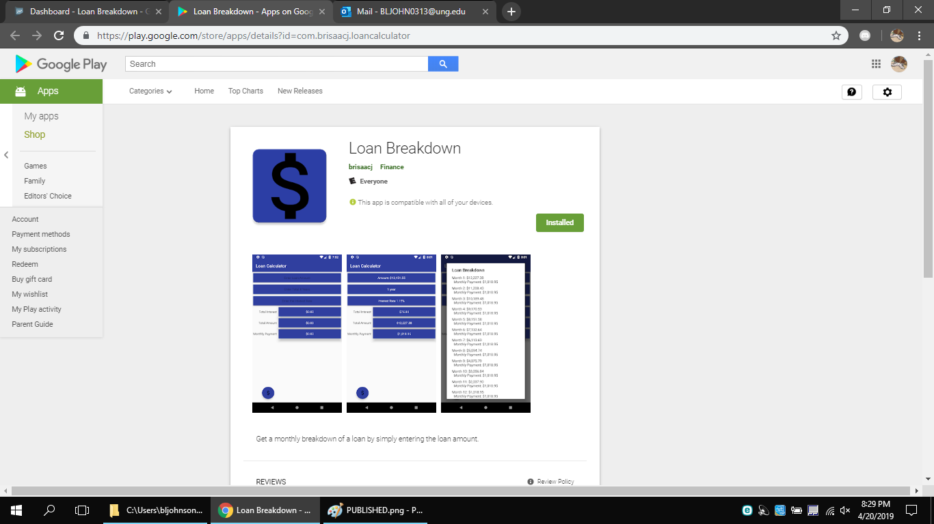
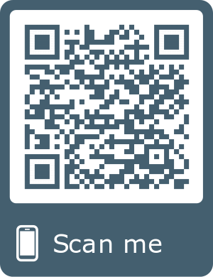
Play Store

